Slide 1


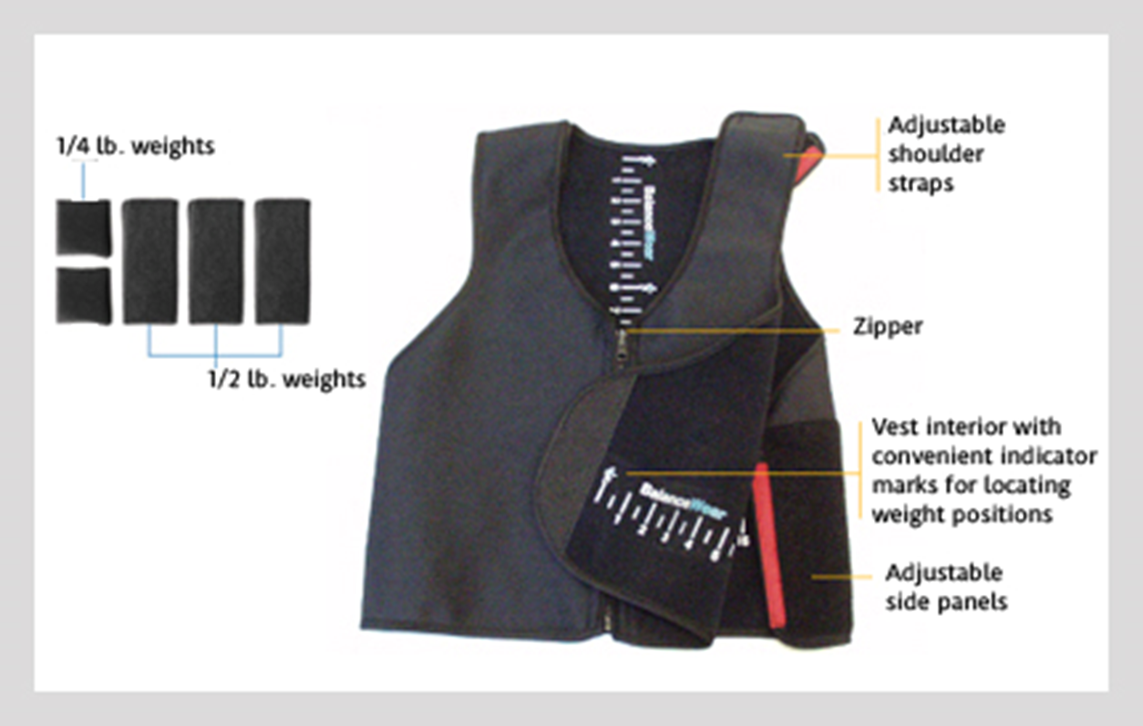

BalanceWear Therapy Impact on Functional Mobility among Older Adults with Impaired Mobility
Vincenzo, J.L.¹, Gray, M.², Gibson-Horn, C.³
¹Department of Physical Therapy, University of Arkansas for Medical Sciences, Fayetteville, AR; ²Office for Studies on Aging, University of Arkansas, Fayetteville, AR; ³Motion Therapeutics Inc, San Francisco, CA
ABSTRACT
Impaired mobility is a risk factor for adverse health events. Balancewear Therapy (BWT) improves immediate or short term mobility among adults with multiple sclerosis and older adults but has not been studied longitudinally. We examined mobility in older adults after 4 months of BWT worn 4 hours daily. Twenty-four adults [aged 87.1 (5.7) years] with mobility impairment without progressive neurological disorder, pain with mobility, or cognitive impairment completed the study. Pre- and post-assessments were five-times sit-to-stand test (FTSST), 4 m gait speed (GS), short physical performance battery (SPPB), and timed up and go (TUG). Participants were evaluated by a trained therapist on postural responses to perturbations small weights were strategically added to the BWT torso orthotic (less than 1.5% body weight) until postural responses improved. Individuals donned BWT for 4 hours daily and continued their usual activities. Paired t-tests indicated all measures were significantly different from pre- to post-tests (p < 0.05) after 4 months of BWT. All measures except for TUG improved beyond published fall risk cut offs and exceeded clinical change. Four months of BWT for 4 hours daily is beneficial in improving functional mobility and decreasing fall risk among mobility-limited older adults.
INTRODUCTION
METHODS
Falls among older adults are a public health issue related to increased morbidity, mortality, and health care costs.¹ Impaired postural control, and functional mobility are prominent risk factors for falls.² Exercise-based interventions vary in effectiveness on improving impairments and decreasing falls among older individuals.^{3,4} Therefore, it is necessary to investigate other means to improve postural control and functional mobility, thereby decreasing fall risk among older adults. BWT is a non-exercise treatment intervention that improves postural control, gait, and functional mobility among adults with multiple sclerosis⁵⁻⁷ and has been shown to improve mobility in older adults as measured by the short physical performance battery after 5 days of wear. ⁸
Thirty participants with mobility impairment measured by SPPB scores 4-9/12⁹ without progressive neurological disorders, pain with mobility, or cognitive impairment who completed a 5-day randomized controlled study continued in a 4-month non-blinded study. Subjects completed a methodologic posture assessment and were given an individually strategically weighted and fitted balance orthotic (BWO) to control their three-dimensional balance loss. Subjects were told to continue regular activity but apply the orthotic twice a day for 2 hours during their most active times. Pre- and post-assessments included FTSST, GS, SPPB, and TUG. Subjects were reassessed 1 X per month to adjust weights according to clinical protocol. Data was analyzed with the SPSS version 22 and significance was set for p=.05.
Figure 1. BalanceWear Orthotic
DISCUSSION
Table 1. FUNCTIONAL ASSESSMENTS
RESULTS
While this study included a small sample size without a control group, results suggest that wearing a BWO 4 hours per/day is feasible and improves fall risk, balance and mobility in a group of older adults with baseline mobility limitations. This intervention may have implications for those who refuse to exercise where a balance orthotic may reduce the risk of falling. Further research would also be beneficial to ascertain if combining rehab with a balance orthotic improves outcomes.
Twenty-four subjects, average age 87.13 (5.71) years completed the study. Paired t-tests indicated all measures were significantly improved from pre- to post-tests (p < 0.05). FTSST improved by 9.88 s [t(15) = -1.843, p = .047].GS improved 0.09 s [t(22) = -3.26, p = .004]. SPPB improved 1.31 units [t(22) = -3.70, p = .001]. TUG improved 3.15s [t(23) = 2.92, p = .008. Furthermore, three measures improved beyond fall risk cut-offs; GS¹⁰, FTSST¹¹, and SPPB¹² and GS¹⁰ and the FTSST¹¹ also improved beyond minimal detectable change.
(1) Center for Disease Prevention. The State of Aging and Health in America, 2013. (2) Nachreiner et al. Circumstances and consequences of falls in community-dwelling older women. J Women's Health, 2007. (3) Sherrington et al. Exercise to prevent falls in older adults: an updated meta-analysis and best practice recommendations. N S W Public Health Bull, 2011. (4) Stevens. A CDC compendium of effective fall interventions: What works for community-dwelling older adults. National Center for Injury Prevention and Control, 2010. (5) Gorgas et al. Gait changes with Balance-Based Torso-Weighting in people with multiple sclerosis. Physiother Res Int, 2014. (6) Widener GL, et al. Randomized clinical trial of balance-based torso weighting for improving upright mobility in people with multiple sclerosis. Neurorehabil Neural Repair, 2009. (7) Hunt et al. Variability in postural control with and without Balance-Based Torso Weighting in people with multiple sclerosis and healthy controls. Phys Ther, 2014. (8) Vincenzo et al. Short-term effect of BalanceWear therapy on mobility in older adults with mobility limitations, JGPT, 2016. (9) Guralnik et al. A short physical performance battery assessing lower extremity function: association with self-reported disability and prediction of mortality and nursing home admission. J Gerontol 1994. (10) Perera et al. Meaningful change and responsiveness in common physical performance measures in older adults. JAGS, 2006. (11) Buatois et al. Five times sit to stand test is a predictor of recurrent falls in healthy community-living subjects aged 65 and older. JAGS, 2008. (12) Huang et al. Performance Measures Predict Onset of Activity of Daily Living Difficulty in Community-Dwelling Older Adults. JAGS, 2010.

