Slide 1
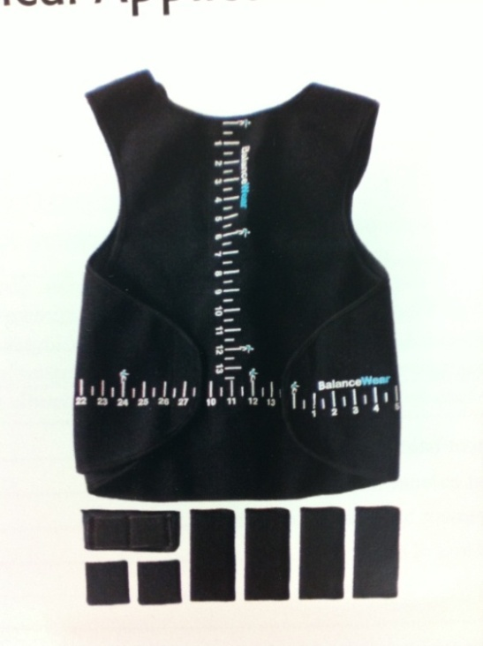
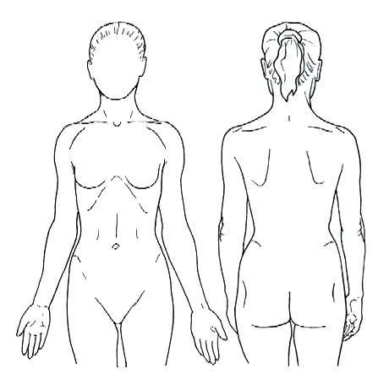
Standing Data Disproves Biomechanical Mechanism for
Balance-Based Torso-Weighting
Ajay Crittendon¹, Danielle O’Neill¹, Gail L. Widener², Diane D. Allen¹
¹Graduate Program in Physical Therapy UCSF/SFSU, ²Physical Therapy Department Samuel Merritt University
Introduction
Data collection and analysis
● Weight placement designation: posterior/ anterior/ equal, right/ left/ central, upper/ lower
● Center of pressure (COP):
Designated medial-lateral (x) and anterior-posterior (y) using BioWare software
Average COP examined in each direction (x, y)
● Weight placement and COP compared in two groups (MS and HS) and four conditions: eyes open (EO) and closed (EC), non-weighted (NW) and weighted (W)
● Statistical Analyses (alpha set at .05)
Chi-square tests compared COP changes with weight placement
Discussion
● Walking impairments can cause frequent falls and limitations in activities and participation in daily life for people with multiple sclerosis (PwMS).¹
● Balance-Based Torso-Weighting® (BBTW), a non-pharmaceutical intervention in which patients wear strategically placed light weights on the trunk, has resulted in immediate functional improvements in PwMS, including increased gait speed.²⁻⁴
● Proposed mechanisms for the effect of BBTW include joint compression, a biomechanical shift reflecting weight placement, increased afferent input about body segments, and improved conscious awareness.
● The purpose of this study was to examine the potential biomechanical mechanism by comparing average weight location after BBTW with the center of pressure changes during quiet standing with and without weights.
If the mechanism behind BBTW was strictly a biomechanical shift, changes in COP would reflect the changes in center of mass in the direction of the greatest weight placements. Therefore, the data would show a high percent of matches between weight placement and the direction of COP changes.
However, these data indicate that COP changes match the direction of weight placement only about 30% of the time. Statistically, we reject the null hypothesis of no difference from random agreement (matching 50% of the time) and we reject the unidirectional alternative hypothesis of high agreement.
A mechanism other than a biomechanical shift appears to have been in effect.
Further research is needed to test alternative mechanisms underlying gains in gait velocity and balance with BBTW.
Despite the weighting average of only 0.9% of body weight (1.38lbs), participants weighted with BBTW had immediate improvement in gait speed.
Results
Some participants showed changes in COP with weighting. Graphs show examples of COP traces. In the x direction, 0 = midline. In the y direction, people faced towards 0, heels at -8.
Methods
Inclusion: diagnosis of MS, physician approval; or, age, height, and weight-matched healthy control
38 female volunteers gave informed consent
Percent agreement between the direction of COP displacement and placement of most weight ranged from 15% to 44.4%
PwMS had lower percentages of agreement than healthy controls but difference was not statistically significant (Chi-square p=0.0512)
Direction of change in average COP displacement from non-weighted to weighted conditions significantly differed from direction of placement of weights.
Many COP displacement changes with weighting were very small. A minimal detectable change (MDC) was calculated using the formula MDC = SD * sqrt (1- correlation r). The chi-square analysis was repeated using a value for direction of change only when change was greater than MDC in each direction. Again, direction of change in average COP displacement significantly differed from direction of placement of weights.
BBTW increased gait velocity in PwMS (t-test, p=0.002) compared to gait without weight.
 | People with MS (n=20) | Healthy controls (n=18)
Mean age in years (SD), range | 49.4 (13.4), 25-68 | 47.3 (11.2), 29-69
Mean years with diagnosis (SD) | 12.8 (8.2)
EDSS score equivalent | 4.1 (1.6), 2-6
Number (%) claiming falls in the past 6 months | 11 (55%) | 2 (11%)
Conclusion
Percent Agreement between Direction of COP Displacement and Weight Placement
While BBTW has been shown to increase gait speed in PwMS, the mechanism for change is unknown. These data disprove the hypothesis of a strictly biomechanical mechanism underlying its effectiveness. Further study is needed to investigate other possible mechanisms for this promising intervention.
 | Eyes Open (x and y directions) | Eyes Closed (x and y directions) | Y Direction (EO and EC) | X Direction (EO and EC) | Total
MS | 30% | 15% | 20% | 25% | 22.5%
HS | 33.3% | 41.7% | 30.6% | 44.4% | 37.5%
Combined | 31.6% | 27.6% | 25% | 34.2% | 29.6%
MS = multiple sclerosis, SD = standard deviation, EDSS = Expanded Disability Status Scale
Completed medical questionnaire listing MS-related symptoms and recent fall history
BBTW protocol²⁻⁴ assessed balance response to perturbations in standing to determine placement of light weights (0.36% to 1.6% body weight) on a snug garment
Quiet standing trials on Kistler forceplate
With torso garment but no weights, participants stood on a forceplate as still as possible for 10 seconds with eyes open, then 10 seconds with eyes closed
With weights on, (0.75-2.75 pounds) participants repeated the two standing trials
MS: Participants with MS; HS: Healthy controls; EO: Eyes open; EC: Eyes closed
Acknowledgement: This study was supported by Award Number R15HD066397 from the Eunice Kennedy Shriver National Institute of Child Health and Human Development. The content is solely the responsibility of the authors and does not necessarily represent the official views of the Eunice Kennedy Shriver National Institutes of Child Health and Human Development or the National Institutes of Health.
References
Nilsagard Y, Lundholm C, Denison E, Gunnarsson LG. Predicting accidental falls in people with multiple sclerosis--a longitudinal study. Clin Rehabil. 2009;23:259-269.
Gibson-Horn C. Balance-based torso-weighting in a person with ataxia and multiple sclerosis: A case report. J Neurol Phys Ther. 2008;32:139-146.
Widener GL, Allen DD, Gibson-Horn C. Balance-based torso-weighting may enhance balance in persons with multiple sclerosis: Preliminary evidence. Arch Phys Med Rehabil. 2009;90:602-609.
Widener GL, Allen DD, Gibson-Horn C. Randomized clinical trial of balance-based torso-weighting for improving upright mobility in people with multiple sclerosis. Neurorehabil Neural Repair. 2009;23:784-791.
Figure 1. BBTWTM Garment and Weights
Figure 2. Sample Weight Placement on Garment
(3 half-pound weights)
Chi-square COP-MDC Agreement with Weight Placement
 | Chi-square value | P-Value
Combined (MS & HS) | 25.289 | 0.0001
MS | 24.2 | 0.0001
HS | 4.5 | 0.0339
COP: center of pressure; MDC: minimal detectable change; MS: participants with multiple sclerosis; HS: healthy controls
All data based on whether COP changes were significantly greater than the minimal detectable change (MDC)
Notes:
1

