Slide 1
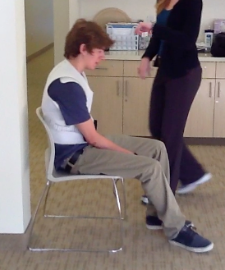
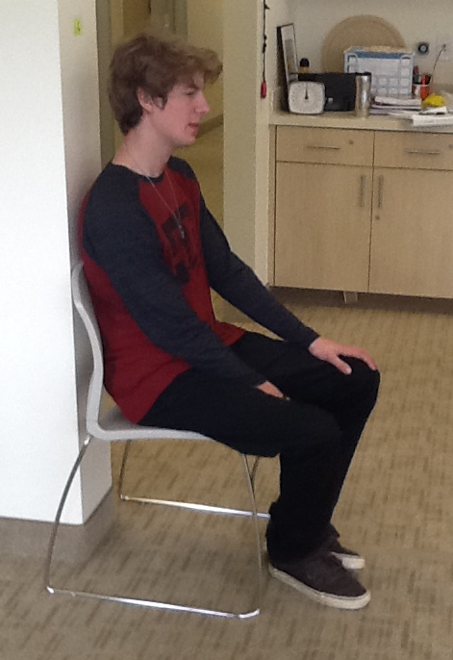
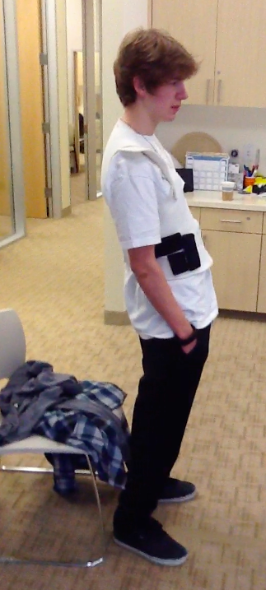
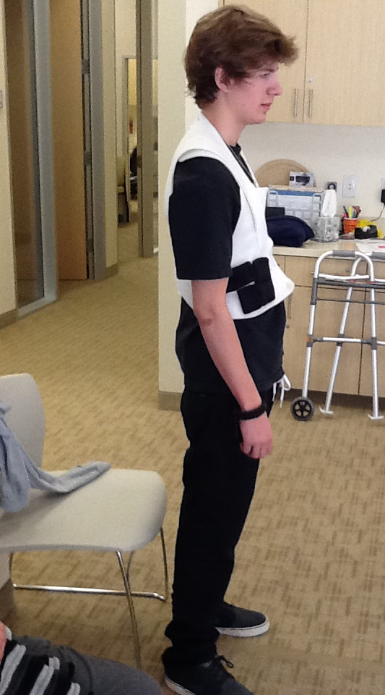
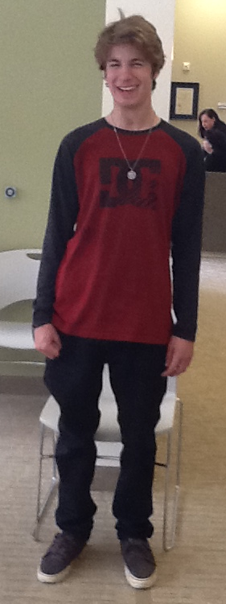
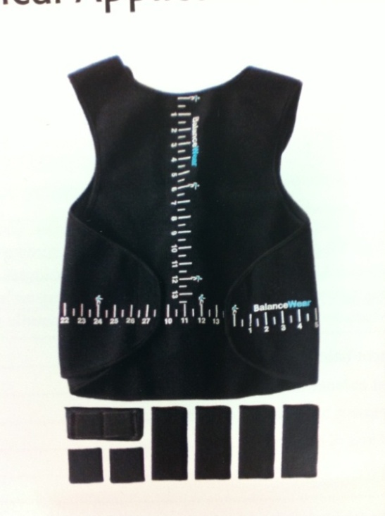
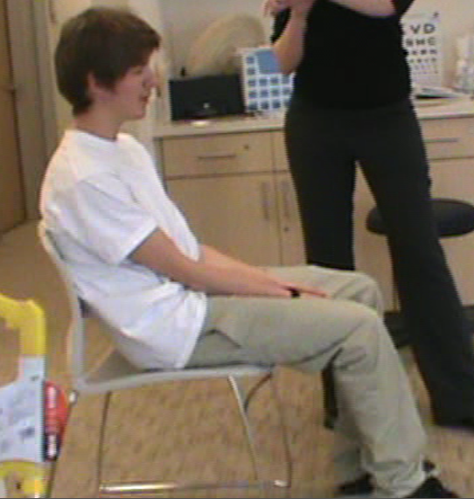
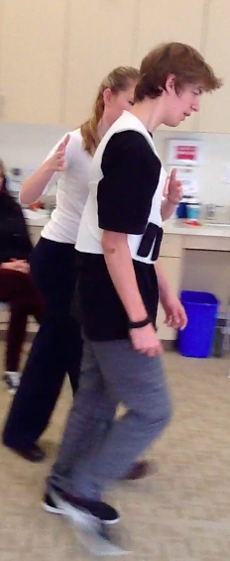
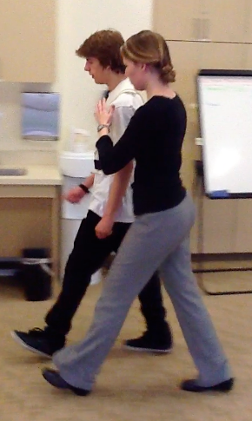
Balance-Based Torso-Weighting For Enhancing Functional Mobility In A Child With Ataxia From Traumatic Brain Injury: A Case Report
Jaclyn Fridolfsson, Cynthia Gibson-Horn*, Gail L. Widener
Physical Therapy Department Samuel Merritt University, Centre of Neuro Skills
Introduction
Therapy Session Outline
Interventions
Outcome Measure Statistical Significance Table
● 1.4 million cases of traumatic brain injury (TBI) in the United States annually with 30% having documented gait, coordination, and balance deficits.¹
● TBI is one of the leading causes of long term disability and long term medical management.²
● Minimal literature validating PT interventions for patients with TBIs according to Bland et al with interventions lacking standardization and low quality outcome measures.³
● Balance-Based Torso-Weighting® (BBTW) is a treatment technology that determines directional impairment. Small weights are strategically placed to improve dynamic and static directional balance loss in a wearable garment called BalanceWear.
● The purpose of this case report was to explore the effectiveness of BBTW in changing impairments and activity limitations of a pediatric patient with ataxia due to chronic TBI.
Assess wear schedule
Re-assess Weighting
Re-assess Outcome Measures
Video Feedback
Assess perceived functional change
Therapy Session Timeline
(13 sessions over 10 weeks)
0 1 2 3 4 5 6 7 8 9 10
LG initially sized and fit with BBTW device and given instructions on a wear schedule for home
Each session followed outline listed to left
When time was available at end of session, performed general strengthening and balance training as done for previous 6 months of PT prior to initiation of BBTW.
Outcomes
Sitting Posture
Standing Posture
Figure 1. BBTWTM Garment and Weights
Discussion
LG showed statistically significant improvements in his TUG, 25 ft Walk Test, 6 minute walk test, and Berg Balance.
Concurrent validity shown between TUG and 25 ft walk test
LG consistently reported minimal perceived functional change between sessions (as shown in self-report outcome measures) despite the statistically significant gains shown across multiple functional outcome measures as well as visual changes shown in videos/pictures.
LG’s mom reported new functional changes at every session: less “wall-walking” at home, walking across open spaces with confidence, less tripping during ambulation, and “having a taller son” with improved postural alignment. LG’s mom state that the BBTW device provided her new hope that her son could be functionally independent and safe in the future.
Case Description
Initial evaluation
● 19 y/o male (LG) in motor vehicle accident June 2011 with resultant TBI, diffuse axonal injury, and multiple fractures
Physical Therapy History:
Acute care Sub-acute rehab
Acute rehab Outpatient
Year 1 Year 2
This case report occurred in the outpatient setting with sessions 1-2x/week for 10 weeks.
LG‘s main functional impairments:
1. Postural alignment in both sitting and standing
2. Gait mechanics and gait speed
3. Static and dynamic standing balance
4. Coordination of UE and LE movements
LG had difficulty self-assessing functional change during the therapy process. The following outcome measures were utilized at regular intervals to objectively assess functional improvement.
Video recordings and pictures were also utilized to show LG visually the changes in his gait quality and posture
After 2 weeks
After 7 weeks
Initial evaluation
After 3 weeks
After 7 weeks
TUG and 25 ft Walk Test Graph
6 Minute Walk Test
Start of BBTW
seconds
Start of BBTW
Conclusion
With use of the BBTW device, LG experienced rapid improvements in balance, posture, gait speed, gait quality, endurance, and coordination greater than standard therapy previously provided.
Romberg Eyes Closed Graph
*Cynthia Gibson-Horn has part ownership of Motion Therapeutics which manufactures and sells BBTW garments.
References
Gibson-Horn, C. (2008). Balance-Based Torso Weighting in a person with ataxia and multiple sclerosis: A case report. Journal of Neurologic Physical Therapy, 32: 139-146
Widener, G.L., Allen, D.D., and Gibson-Horn, C. (2009). Balanced-Based Torso-Weighting may enhance balance in persons with multiple sclerosis: Preliminary evidence. Arch Phys Med Rehabil, 90: 602-609
Widener, G.L., Allen, D.D., and Gibson-Horn, C. (2009). Randomized clinical trial of Balance-Based Torso Weighting for improving upright mobility in people with multiple sclerosis. Neurorehabil Neural Repair, 23: 784-791
Functional Measures^{19,20,21,22,23}
Berg Balance Scale *
25 Foot Walk Test *
6 Minute Walk Test
Timed Up and Go (TUG) *
Romberg *
Rapid Alternating Movement Tests
Self-report measures ^{24,25}
ABC Scale
Modified Falls Efficacy Scale
Gait Mechanics Changes
seconds
Increased foot clearance during swing phase
Improved trunk alignment
Beginning arm swing
Decreased lateral deviation in stepping
Consistent heel strike
* Used in previous BBTW research
Notes:
1

